Slide 1
WEB STACK PROJECT
Blogging App
Presented by:
Aaron Joju(2347201)
Ashwin Joshy(2347216)
Sona Sabu(2347258)

Slide 2
Content Slide
S.No. | Title
1. | Abstract
2. | Introduction
3. | H/w and S/w requirements
4. | Project description ( modules )
5. | Conclusion
6. | Screenshots

Slide 3
Abstract
This abstract introduces a MERN (MongoDB, Express.js, React, Node.js) stack-based blogging application featuring modules for user registration, login, post creation, updating, deletion, as well as post liking and sharing. Users can create engaging content with titles, descriptions, and optional images, while enjoying secure user management. The application's integrated like and share functionalities promote user interaction and community engagement, providing a comprehensive and interactive platform for bloggers to connect with their audience and share their thoughts seamlessly.

Slide 4
Introduction
In the digital age, blogging has evolved into a powerful means of self-expression, knowledge sharing, and community building. With the rise of technology, the process of creating and managing a blog has become increasingly sophisticated. One way to embark on this journey and harness the full potential of modern web development is through the MERN stack, a robust technology stack that leverages the power of MongoDB, Express.js, React, and Node.js.
Our MERN stack blogging React app represents the culmination of this evolution. This application is designed to empower bloggers, content creators, and enthusiasts with a suite of features that facilitate their creative process and foster community engagement. The app comprises several essential modules, each playing a pivotal role in ensuring a seamless and enriching blogging experience.

Slide 5
Hardware Requirements for Blog App
RAM: Minimum 8GB RAM
Processor: Dual-core or higher
Storage: SSD recommended for faster performance
Internet Connection: Stable broadband connection for streaming and updates
Display: Standard computer screen
Software Requirements for Blog App
Web Browser (e.g., Chrome, Firefox, Safari)
Operating System (e.g., Windows)
React.js (Front-end Framework)
Node.js (Back-End-Framework)
Database (MongoDB)

Slide 6






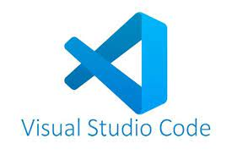
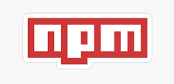
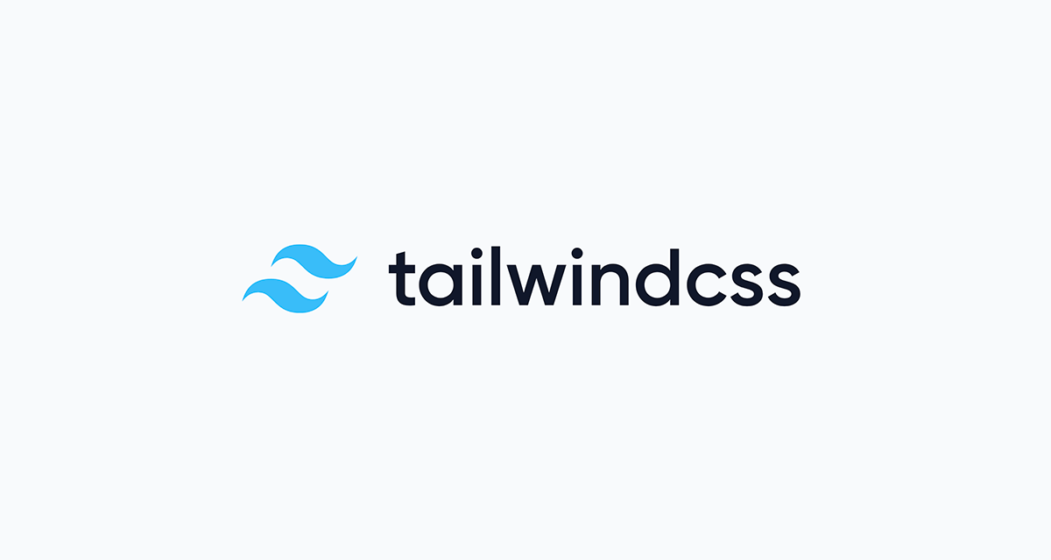

Software Used

Slide 7
Modules
User Registration and Login: Seamlessly onboard new users and provide a secure login mechanism, ensuring user privacy and access control.
Create Post: Enable bloggers to craft engaging content with ease. Users can input a title, description, and even include images to make their posts visually appealing.
Update Post: Content evolves over time, and this feature allows bloggers to make edits or updates to their published posts.
Delete Post: For situations where content is no longer relevant, the ability to delete posts ensures a clutter-free and up-to-date blog.

Slide 8
5. Like Post: Foster engagement and user interaction by allowing readers to show appreciation for posts through likes.
6. Share Post: Extend the reach of your content by providing sharing options, allowing users to easily distribute your posts across various social media platforms.

Slide 9
CONCLUSION
The MERN stack, with its flexibility and scalability, is the ideal foundation for this blogging application. MongoDB provides a reliable and scalable database for storing content and user data. Express.js offers a robust backend framework, ensuring smooth data handling and API interactions. React, the popular frontend library, provides a dynamic and responsive user interface, while Node.js powers the backend to handle requests efficiently.
By bringing together these technologies and features, our MERN stack blogging React app empowers bloggers and readers alike to embark on a journey of creativity, knowledge sharing, and community building in a user-friendly and engaging environment. Whether you're a seasoned blogger or just getting started, this app has something to offer everyone, and it's all made possible by the strength and versatility of the MERN stack.

Slide 10
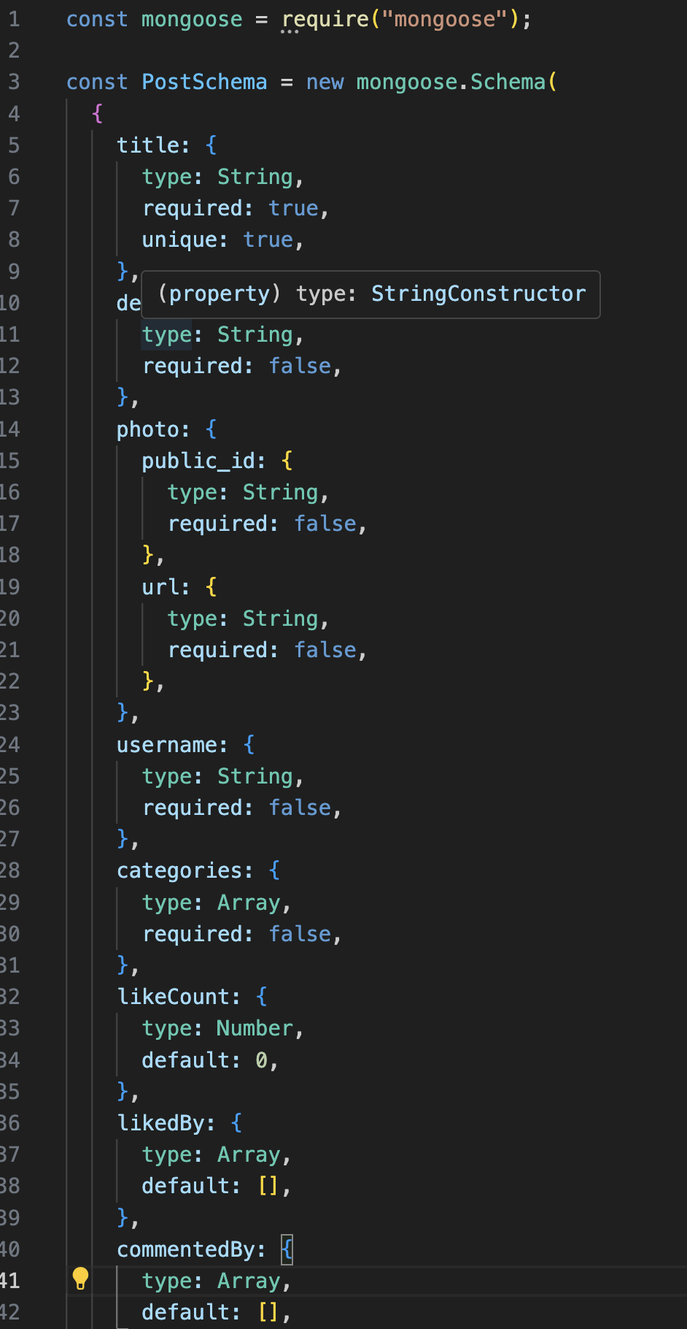
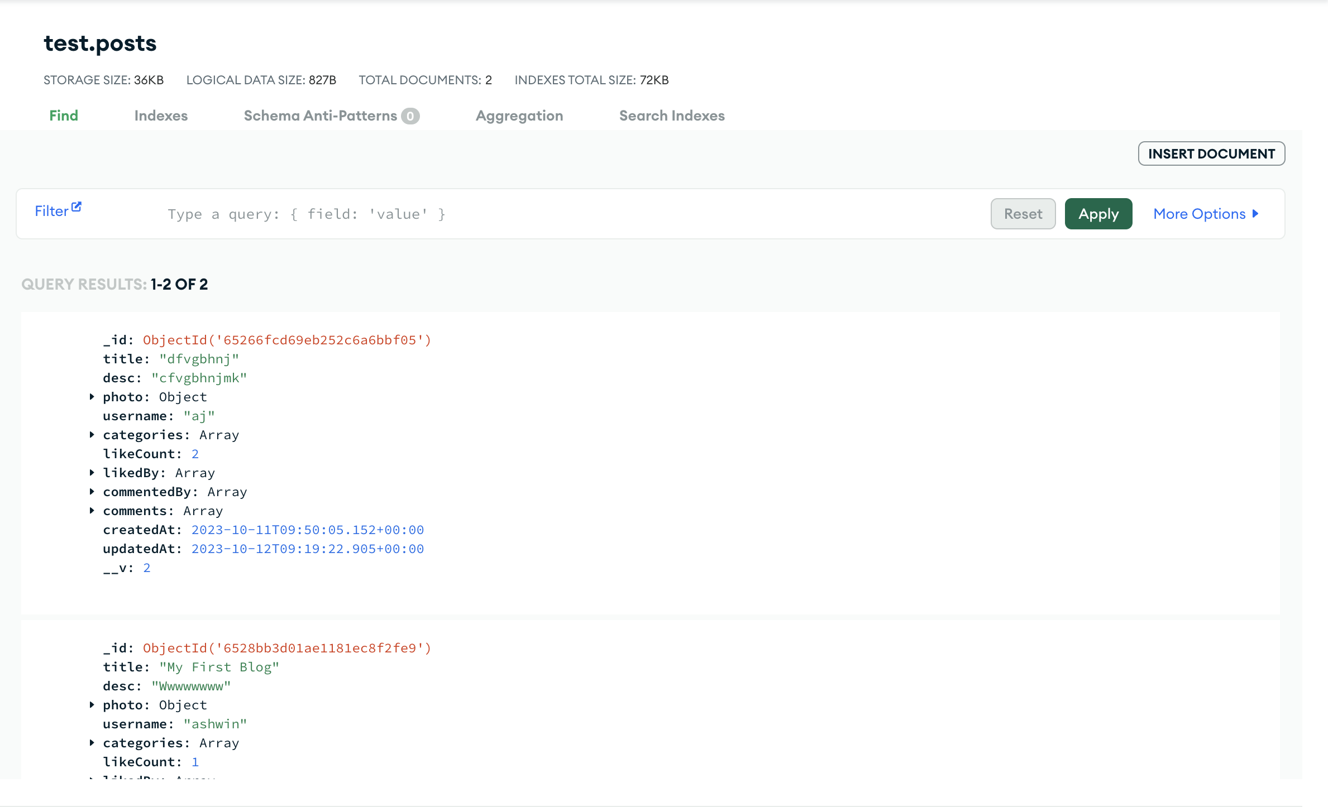
Data Dictionary
Post-Collection

Slide 11
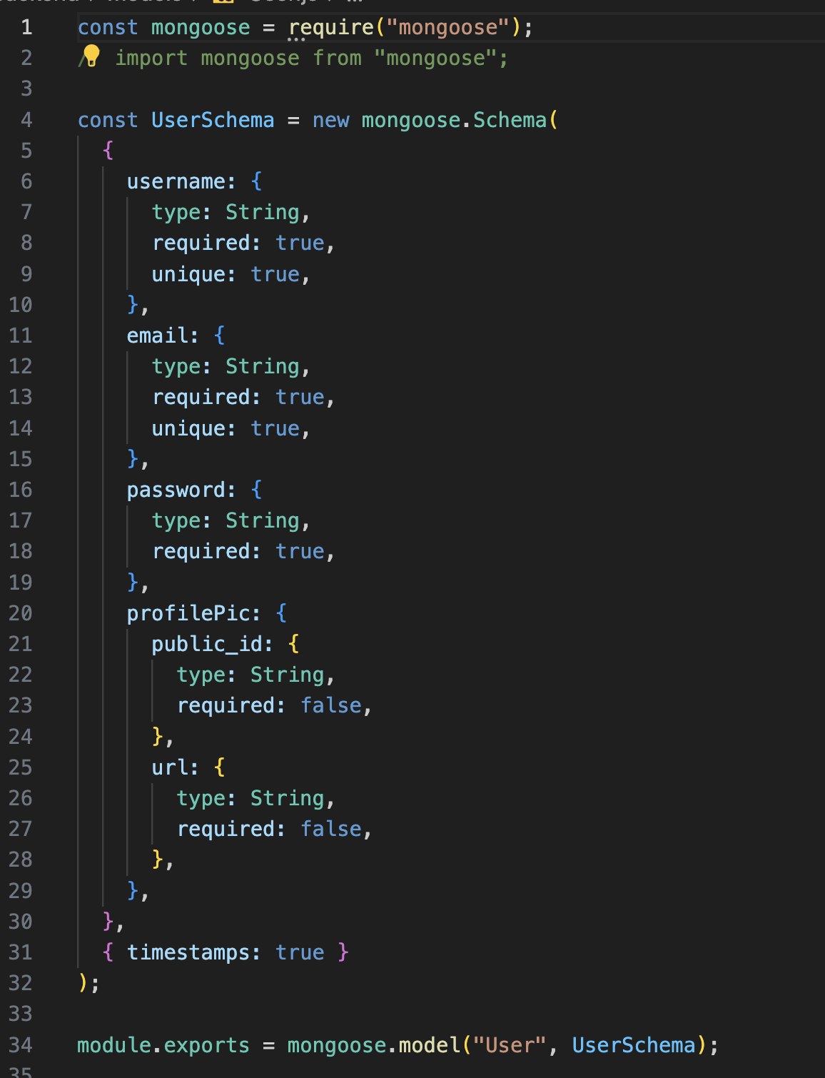
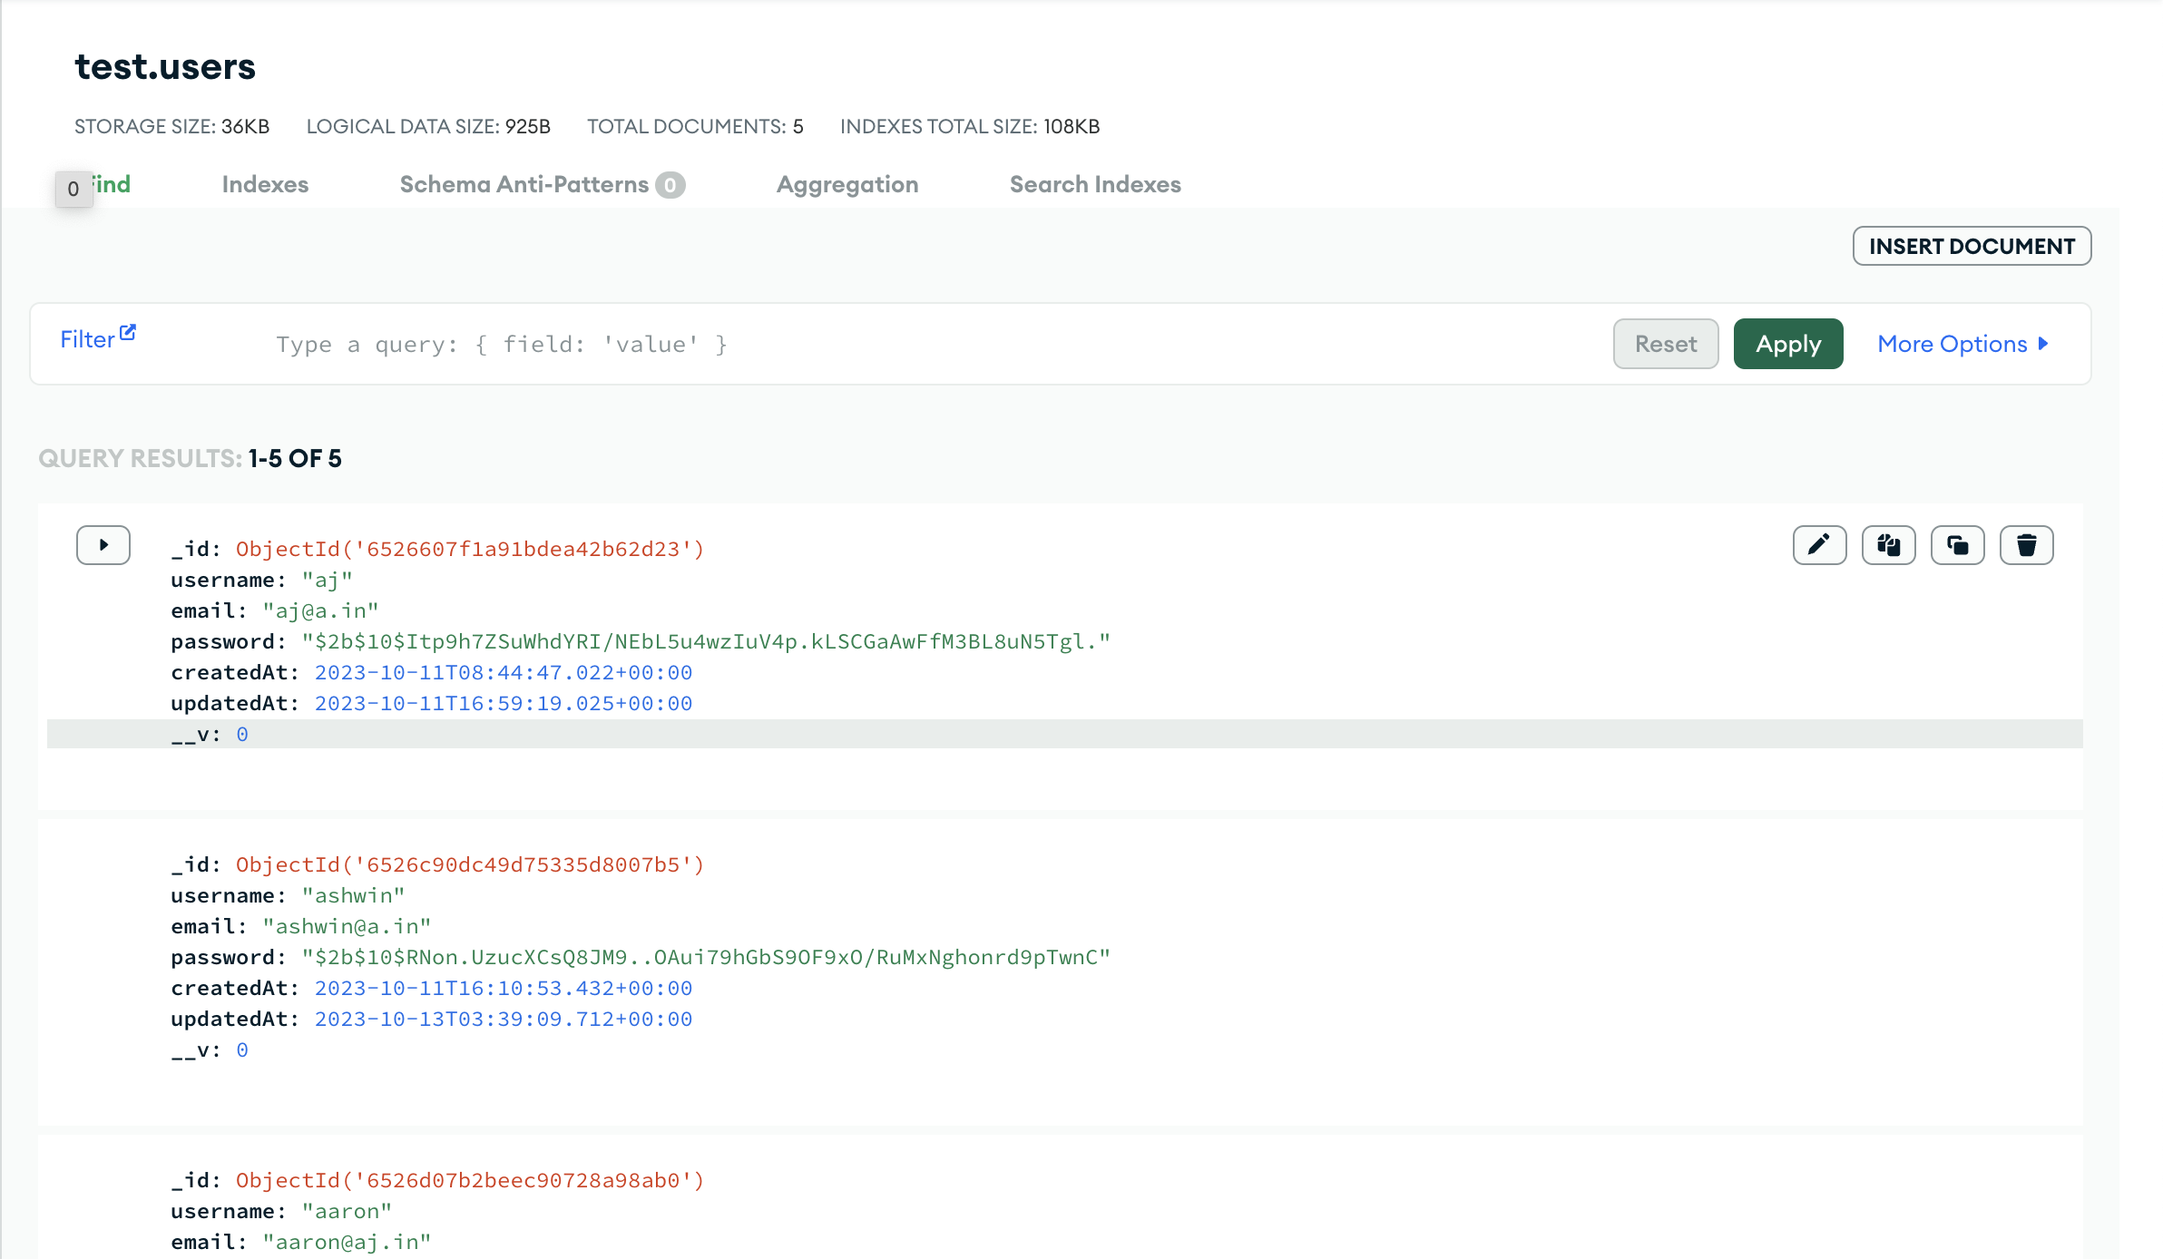
USER-Collection

Slide 12
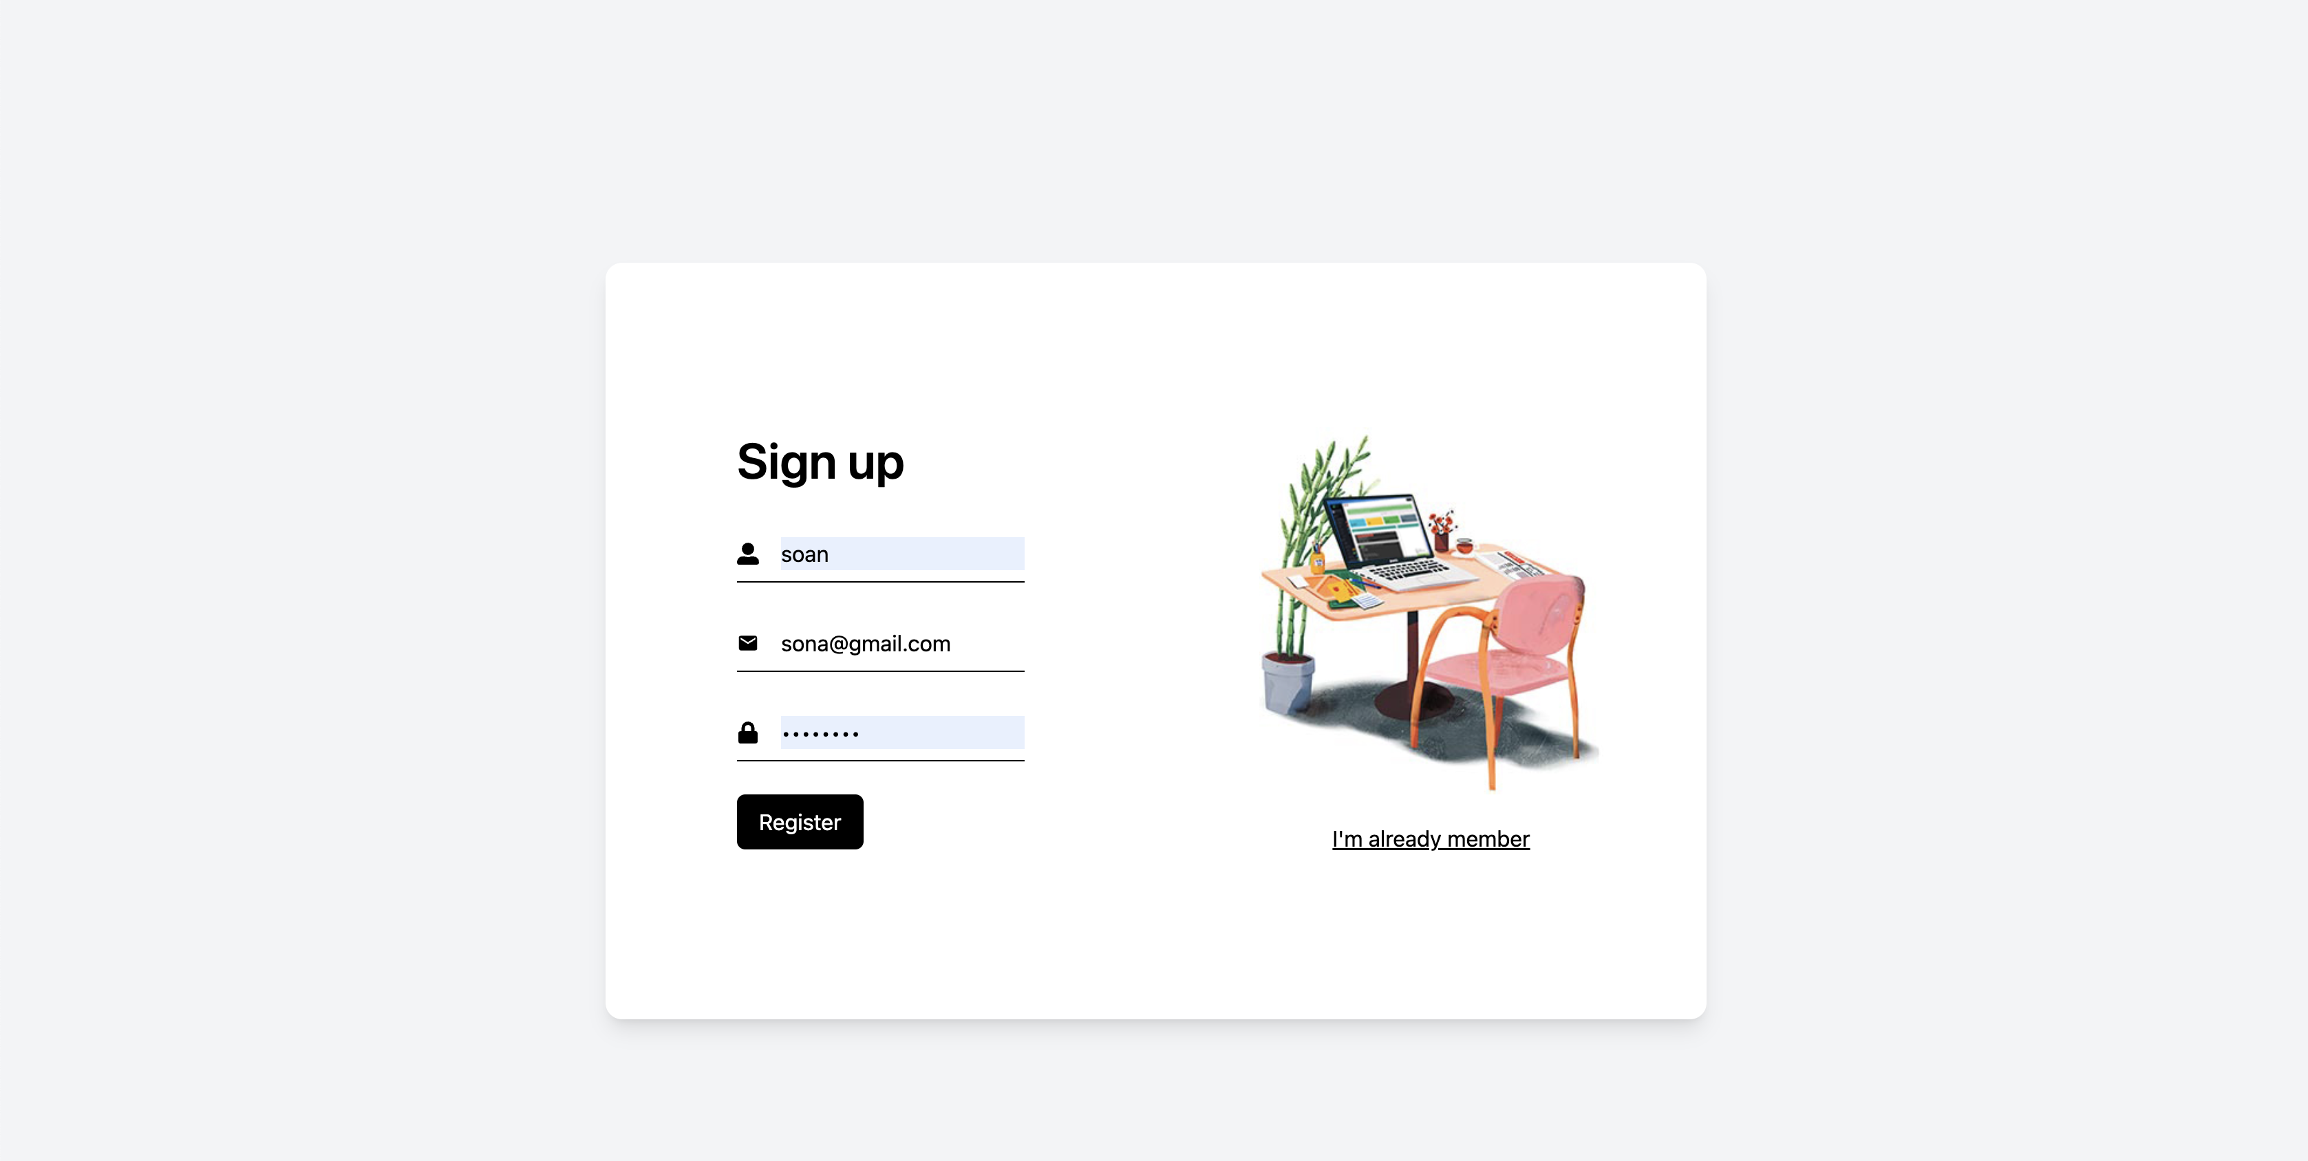
User Interface: Sign Up PAGE

Slide 13
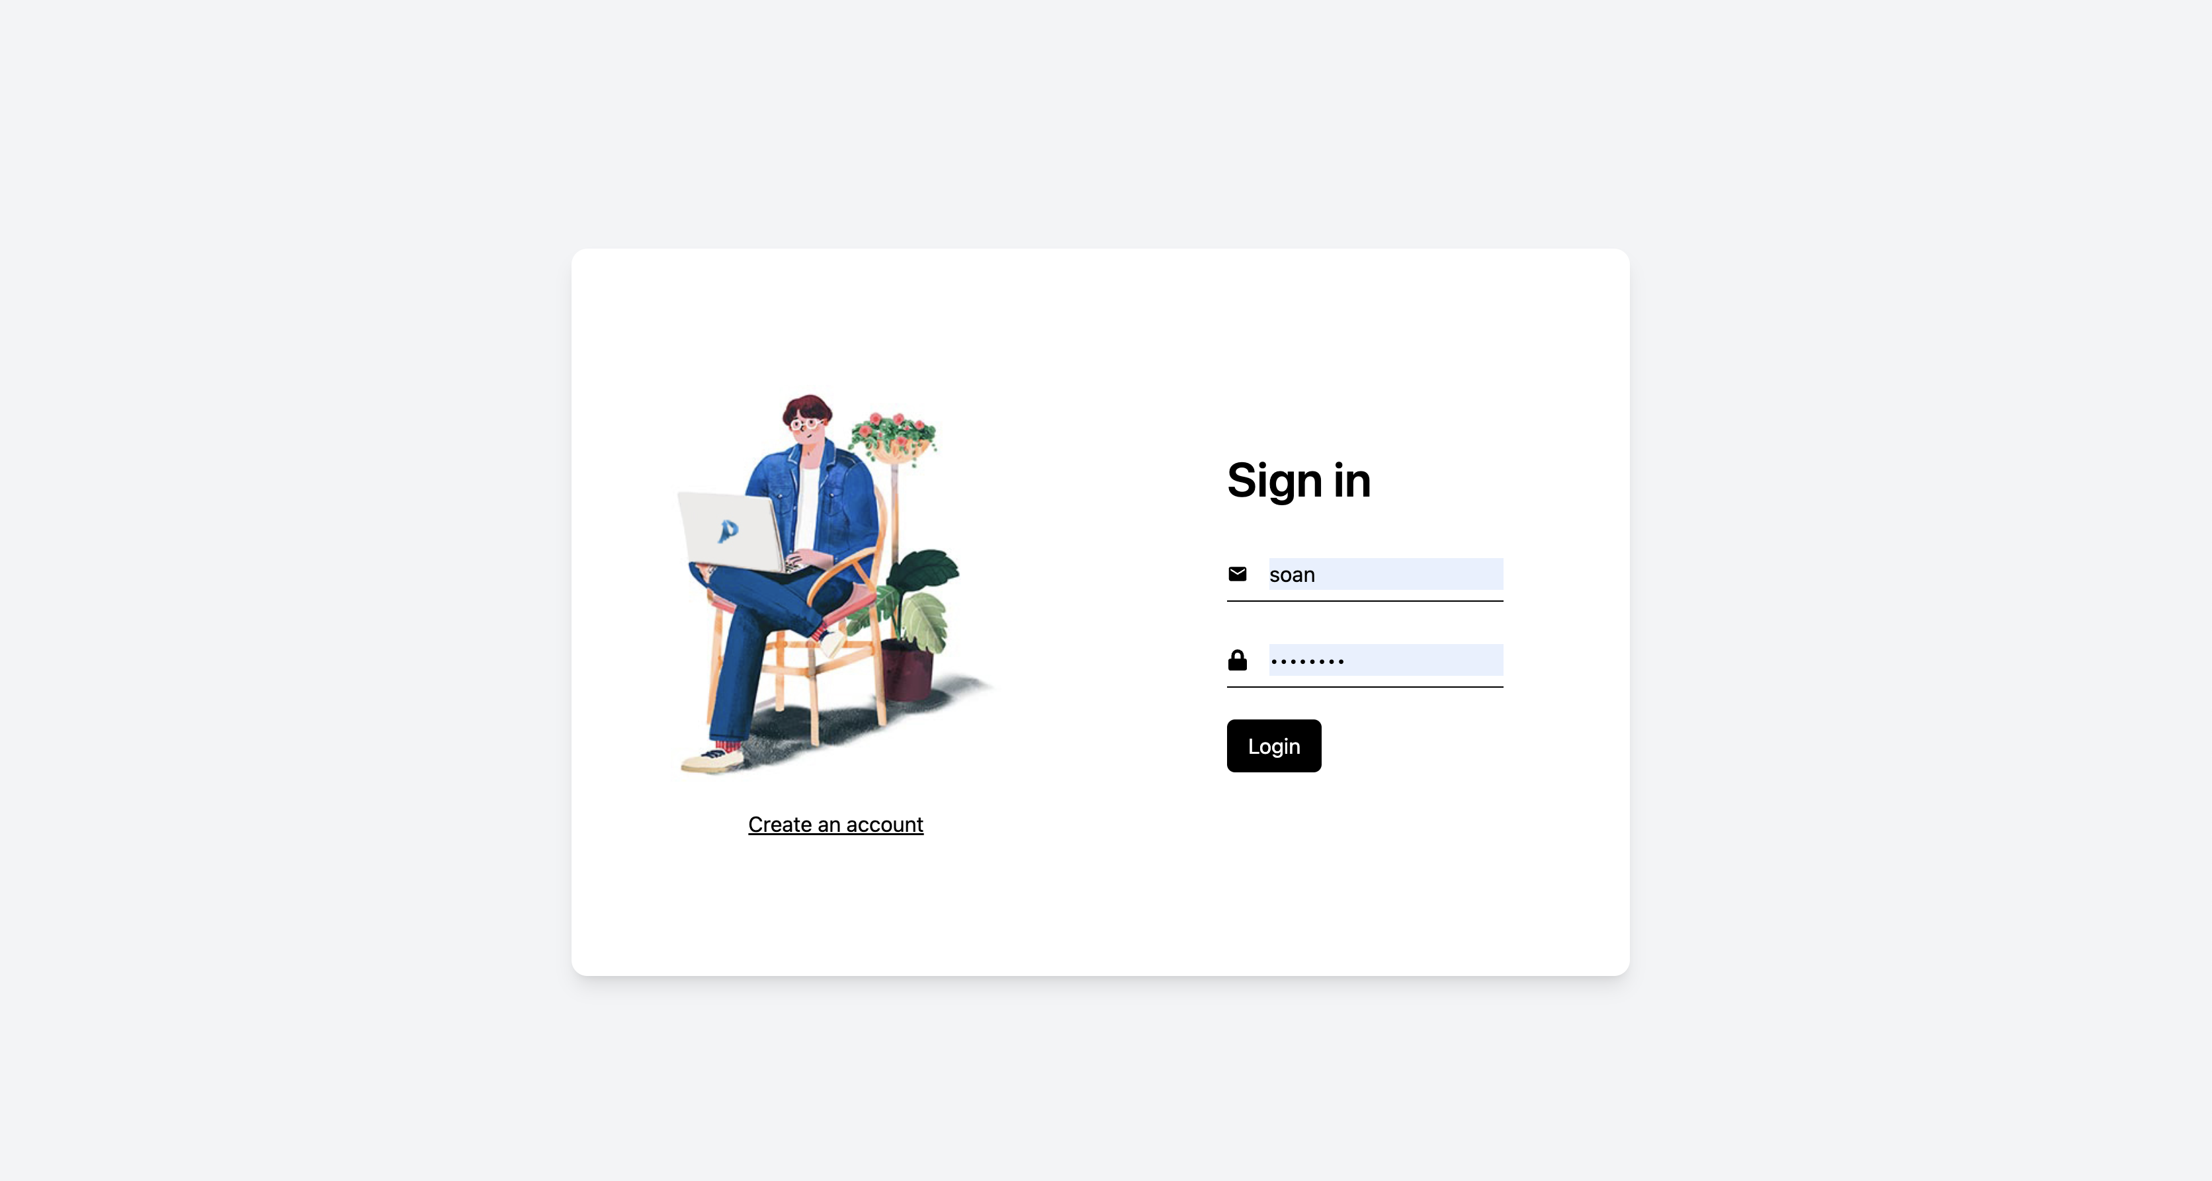
User Interface: Sign In PAGE

Slide 14
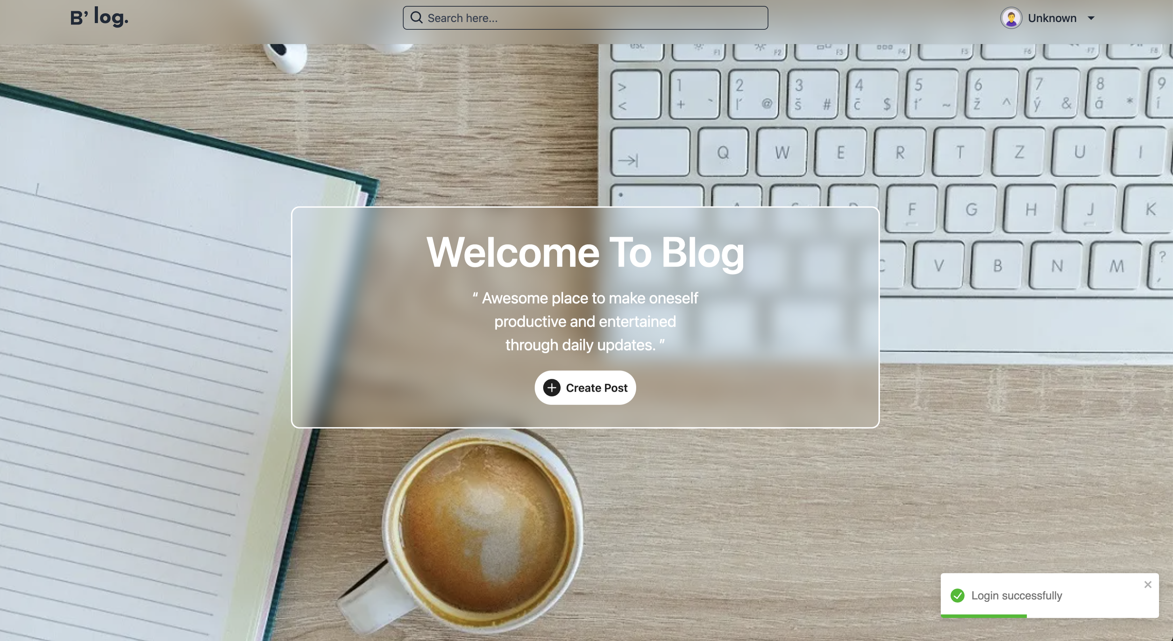
User Interface: Home PAGE

Slide 15
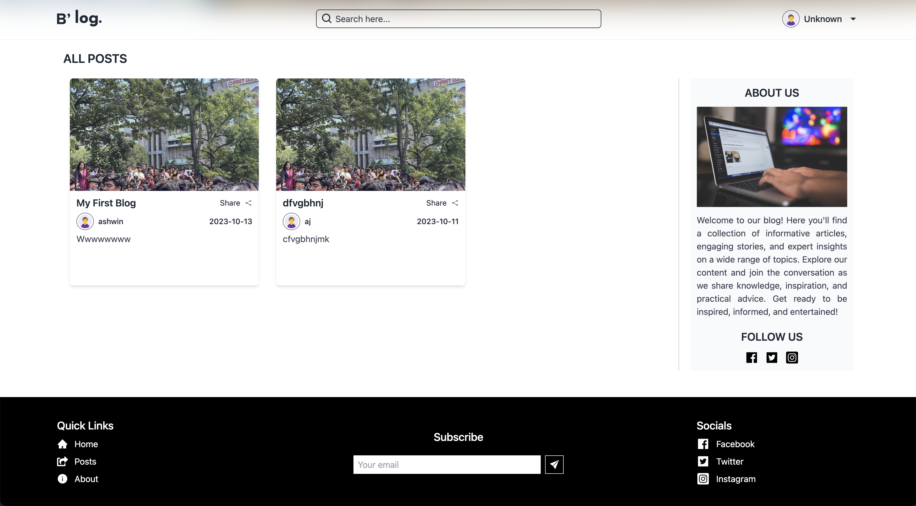
User Interface: Display PAGE

Slide 16
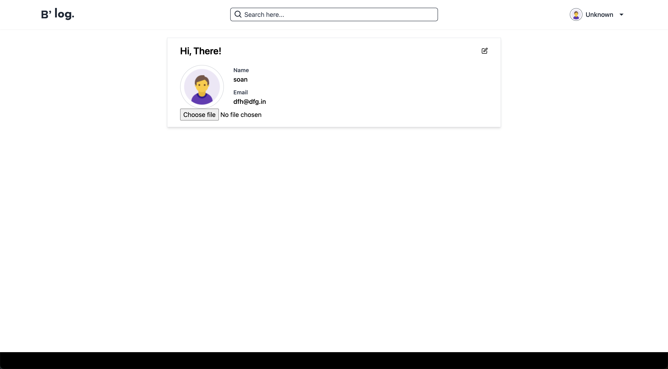
User Interface: Profile PAGE

Slide 17
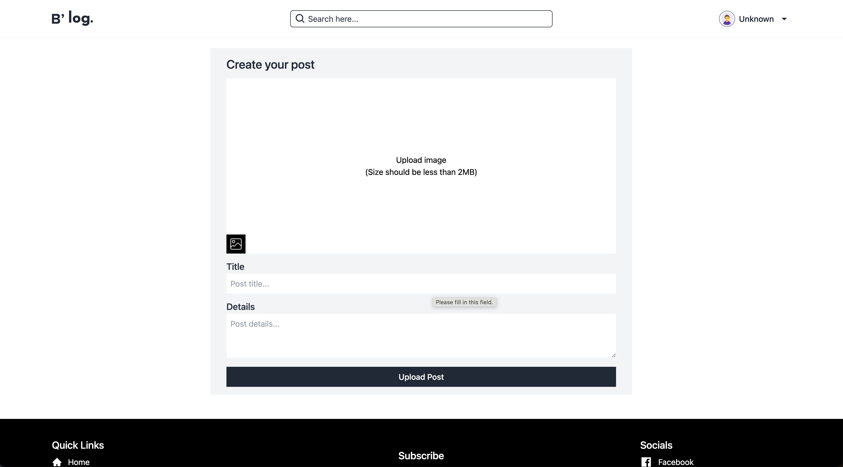
User Interface: AddPost PAGE

Slide 18
Thank You

